Slide 1
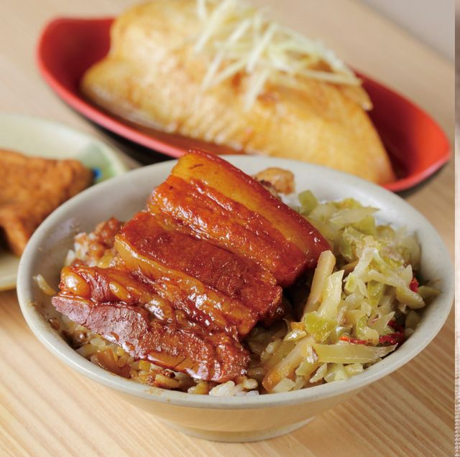





Taiwan Xiao-Chi
Differ between Northern and Southern Xiao-Chi
Northern Xiao-Chi
Southern Xiao-Chi
Shopping List
Khong Bah Png
“Kong Bah Png” or in Mandarin “Kong Rou Fan” in northern Taiwan, or “Lu Rou Fan” in southern of Taiwan, which is also braised pork like Lo Bah Png, the main differ between them is that “Ong Bah Png” is a whole piece of pork but ”Lo Bah Png” would cut pork into minced before braising.
Recipe
Basically, the cooking method of Kong Bah Png are familiar.
In a POT, heat oil over medium heat. Add shallots and fry until they turn brown. Knead the step 1 for 5 to 10 minutes when it’s turn to a smooth ball and then add the butter to mix evenly.
Add ginger and meat. Stir-fry until the meat is cooked and broken apart. We separate the dough into a small balls for one after the dough arise to twice bigger than the original size.
Add Lo Bah Png spices, soy sauce, wine, sugar, and water.
Cover and cook over medium-low heat for 1 hour, stirring occasionally.
Add it to shopping list!
Taiwan Xiao-Chi
Northern Xiao-Chi
Southern Xiao-Chi
Differ Between northern and Southern Xiao-Chi
Shopping List

